Slide 1
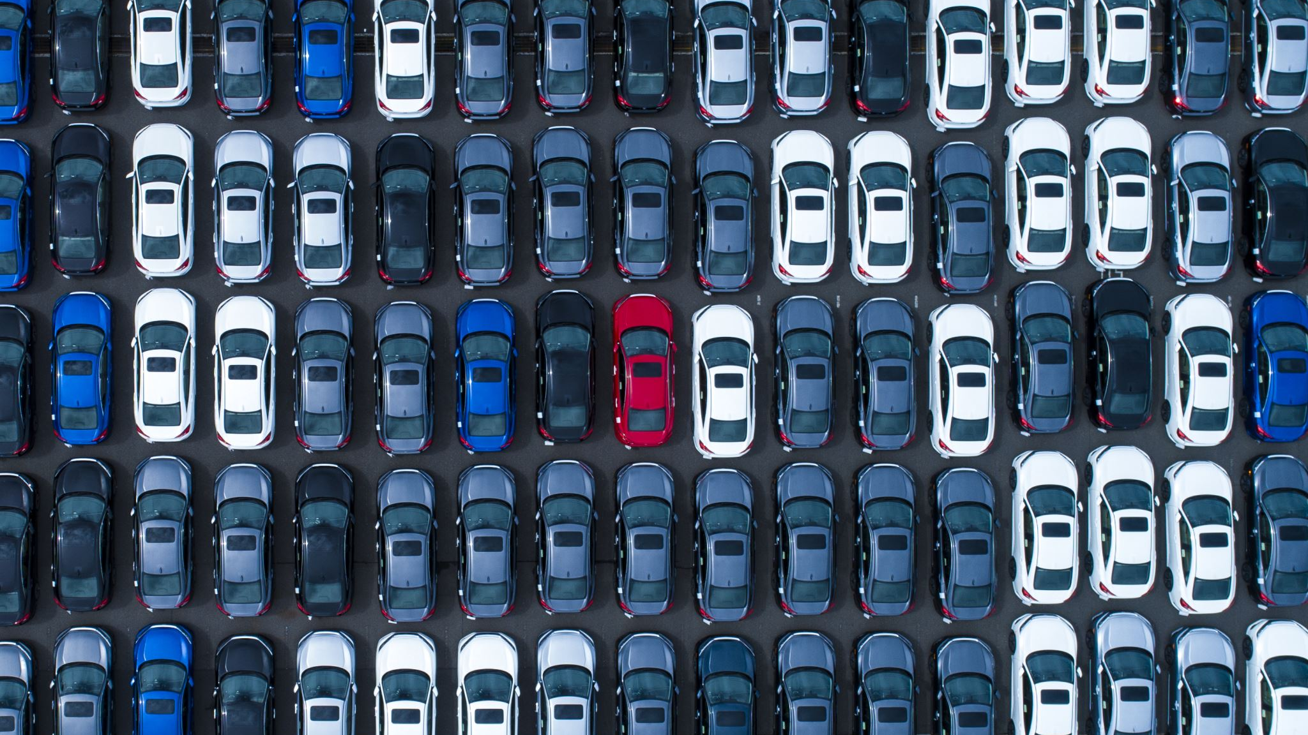
Types of vehicles

Slide 2
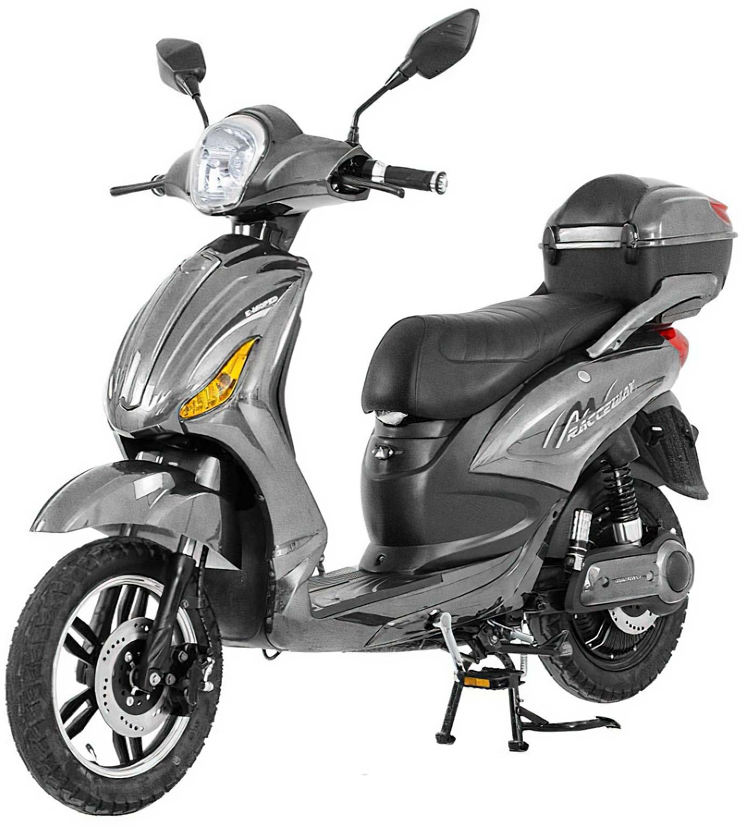
MOPED
A moped is a small motorcycle.
It has a small engine.

Slide 3
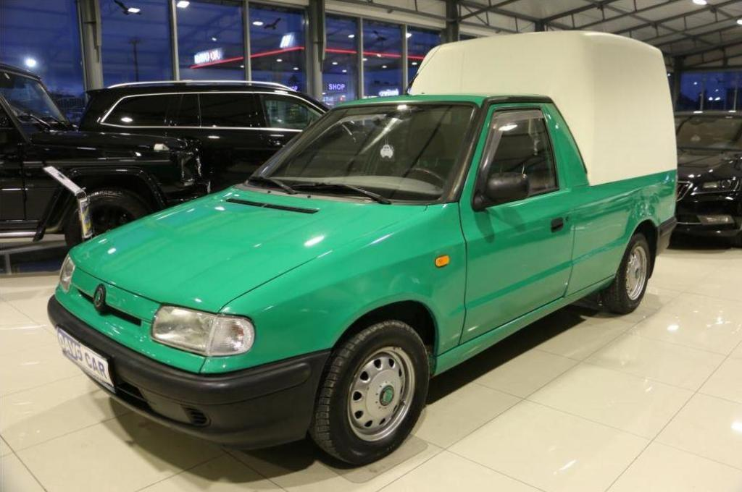
2) PICK-UP
A pick-up is a small truck.
It carries cargo in an open back.

Slide 4
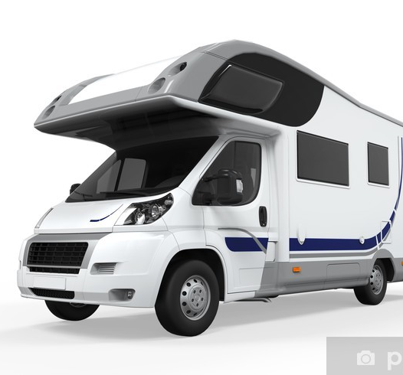
3) CAMPER
A camper is a vehicle for travelling and sleeping.
It has a bed inside.

Slide 5
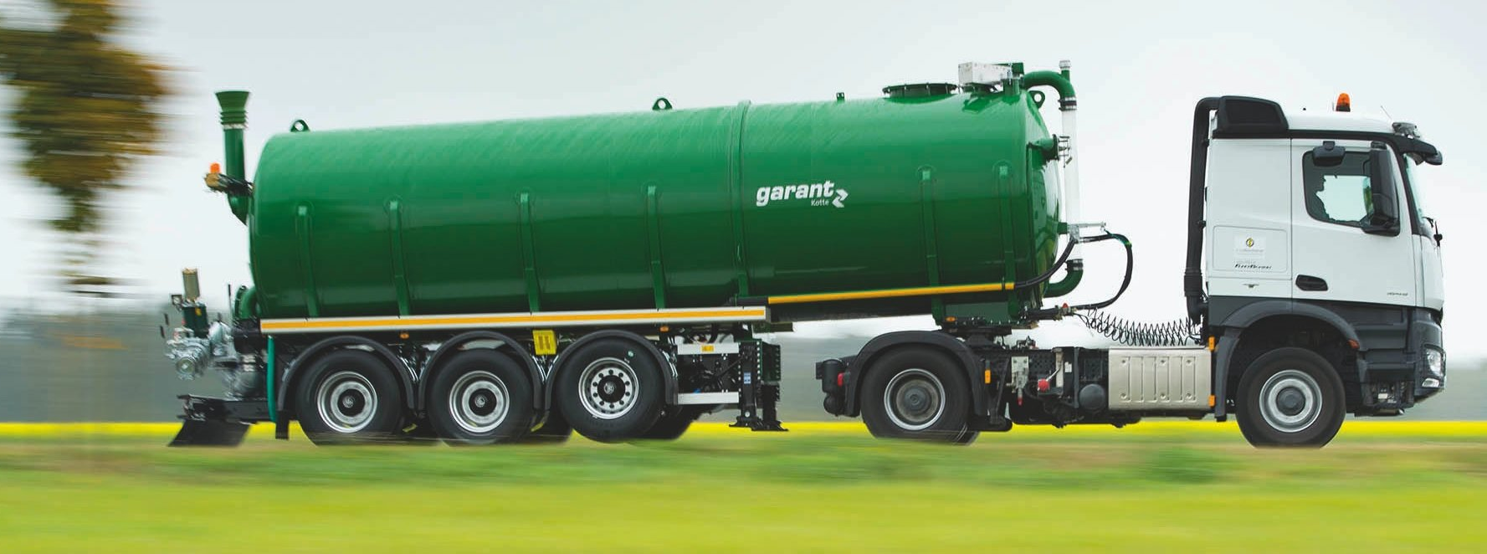
4) TANKER
A tanker is a lorry with a large tank.
It carries liquids, for example petrol or milk.

Slide 6
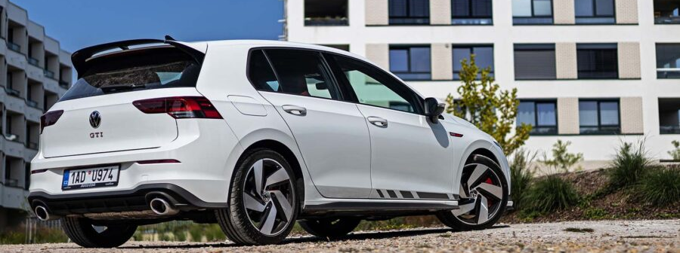
5) HATCHBACK
A hatchback is a car with a large rear door.
The boot and passenger area are connected.

Slide 7
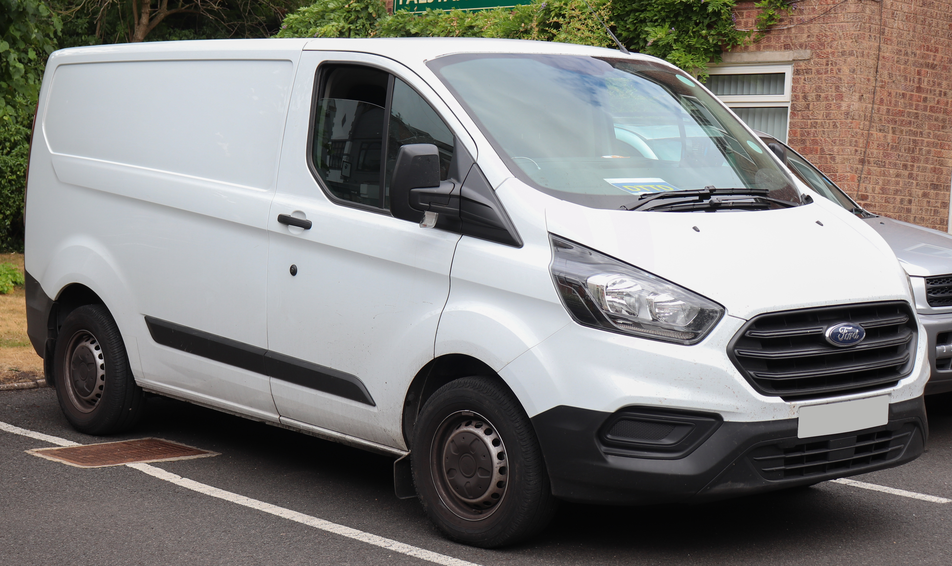
6) VAN
A van carries people or cargo.
It has more space than a car.

Slide 8
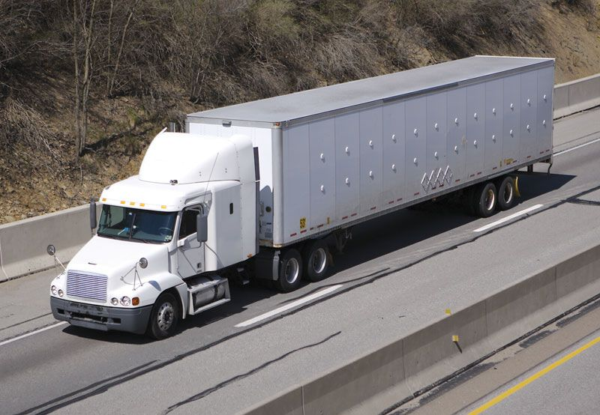
7) TRUCK
A truck is a large vehicle for carrying cargo.
It can carry heavy things.

Slide 9
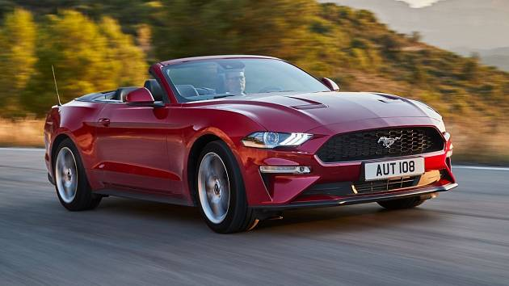
8) CONVERTIBLE
A convertible is a car with a roof that opens.
You can drive it with the roof up or down.

Slide 10
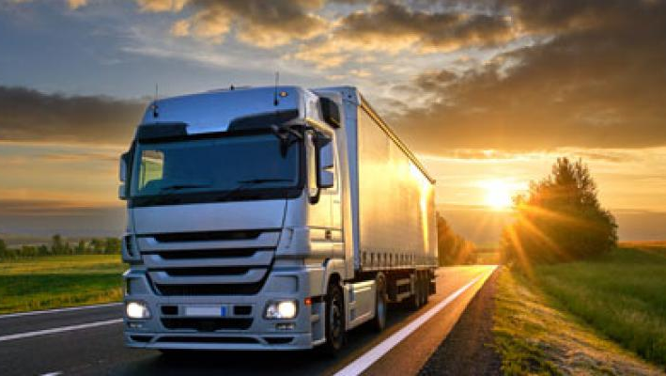
9) LORRY
A lorry is a large vehicle for carrying cargo.
In American English, it is called a truck.

Slide 11
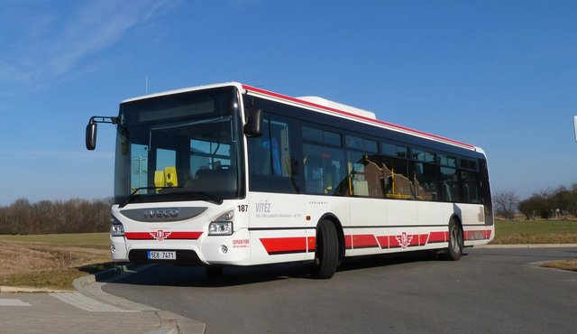
10) BUS
A bus carries many people.
It usually travels on a fixed route.

Slide 12
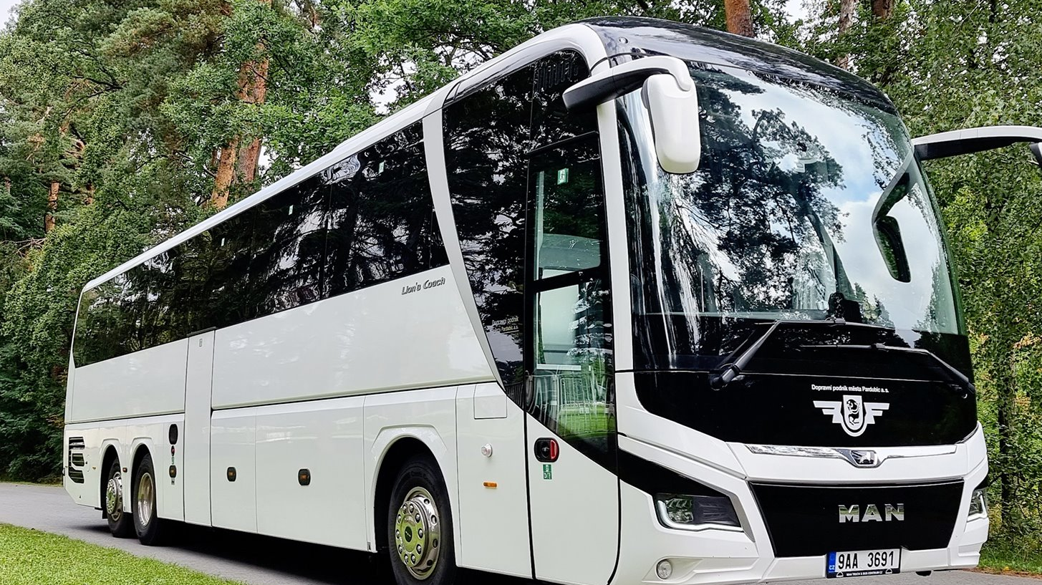
11) COACH
A coach is a bus for long journeys.
It carries passengers between towns or countries.

Slide 13
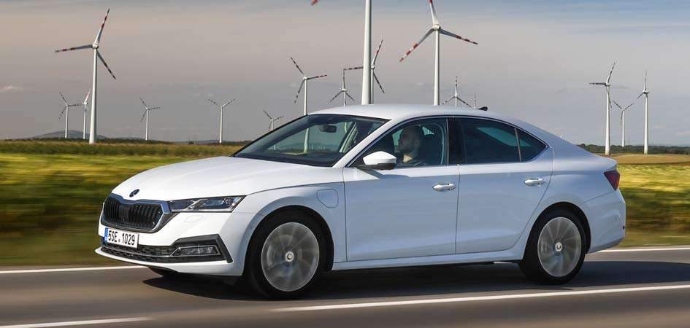
12) SALOON
A saloon is a car with a separate boot.
In American English, it is called a sedan.

Slide 14
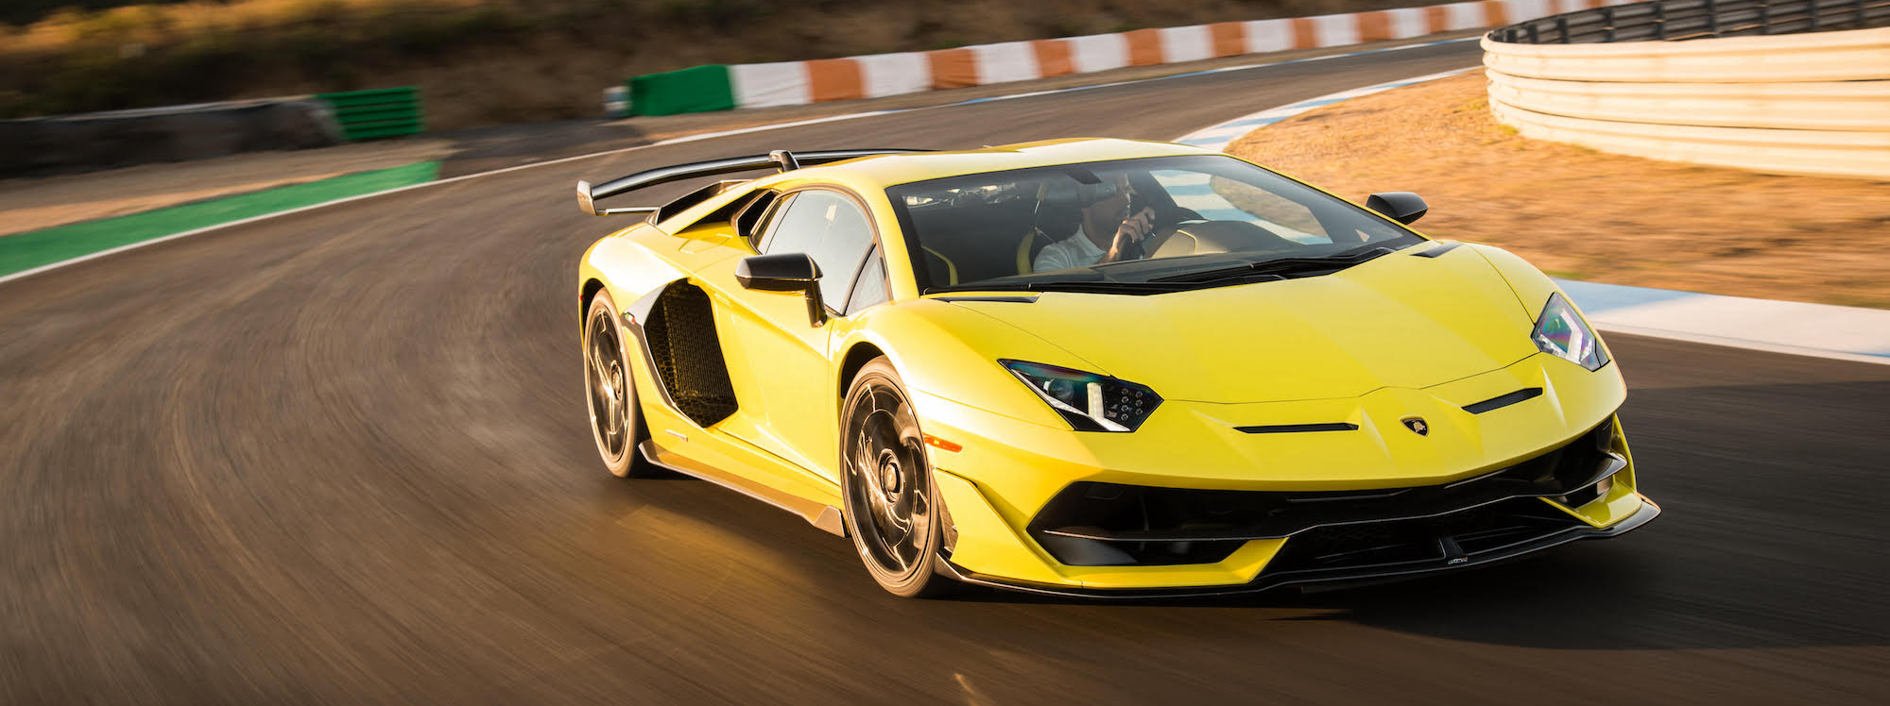
13) SPORTS CAR
A sports car is fast and usually has two doors.
It is made for speed.

Slide 15
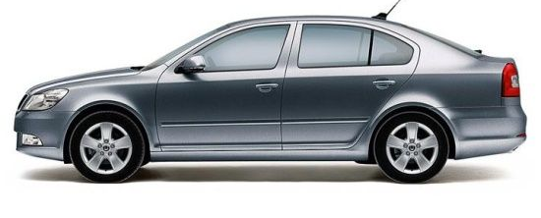
14) LIFTBACK
A liftback looks like a saloon but has a large rear door.
The rear window opens with the door.

Slide 16
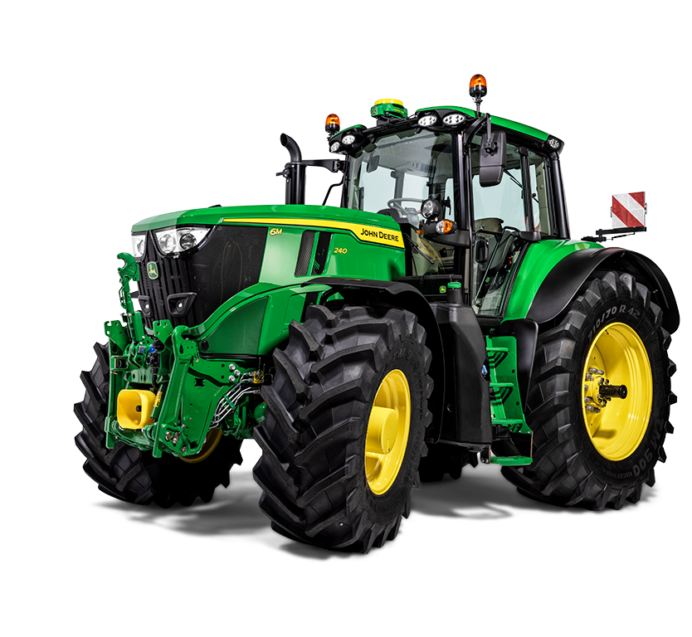
15) TRACTOR
A tractor is used on a farm.
It pulls machines and trailers.

Slide 17
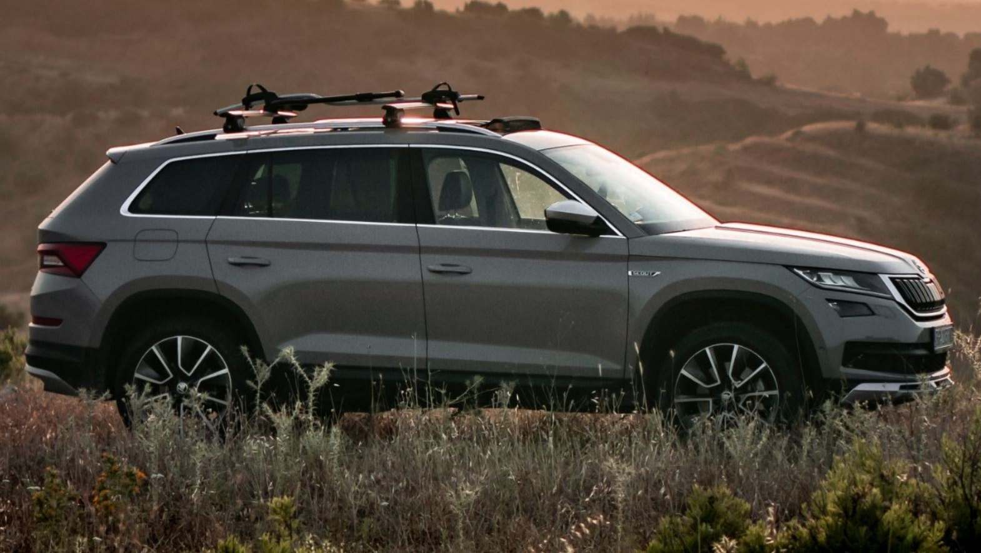
16) SUV (sport utility vehicle)
An SUV is higher than a normal car.
It can drive on roads and rough tracks.

Slide 18
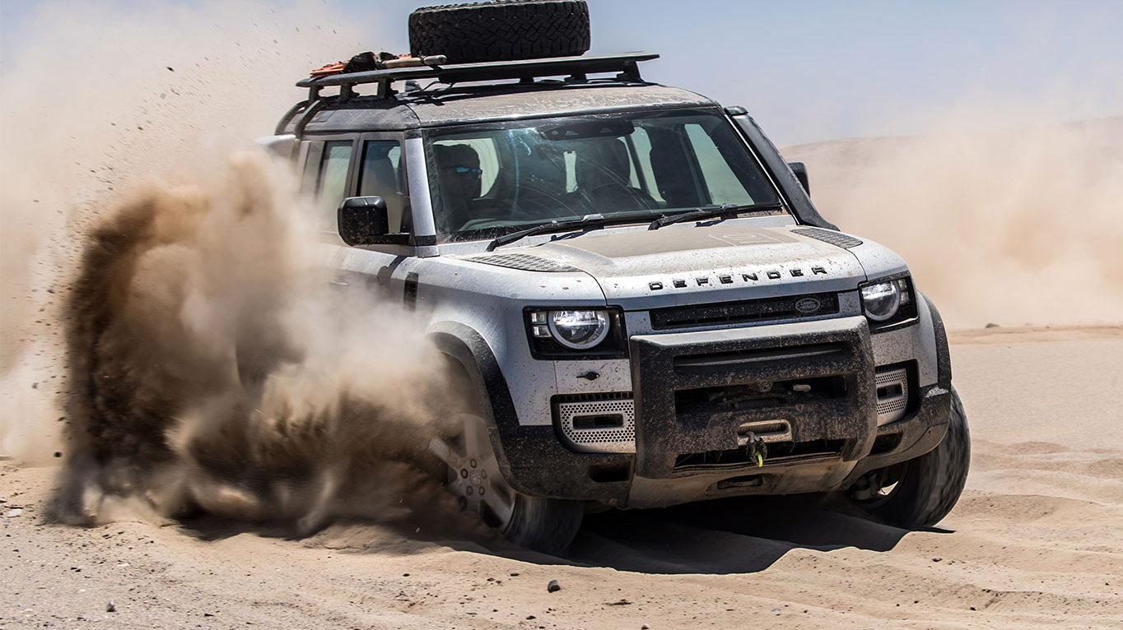
17) OFF-ROAD
An off-road vehicle can drive on rough ground.
It is made for roads without tarmac.

Slide 19
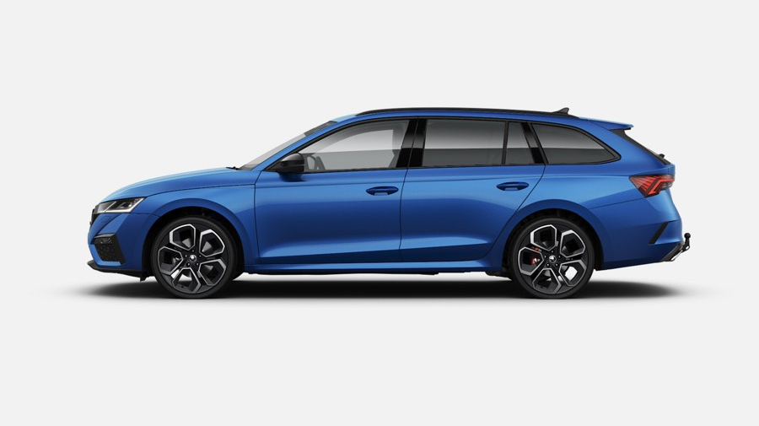
18) ESTATE CAR
An estate car has a large boot.
It is good for families and luggage.

Slide 20
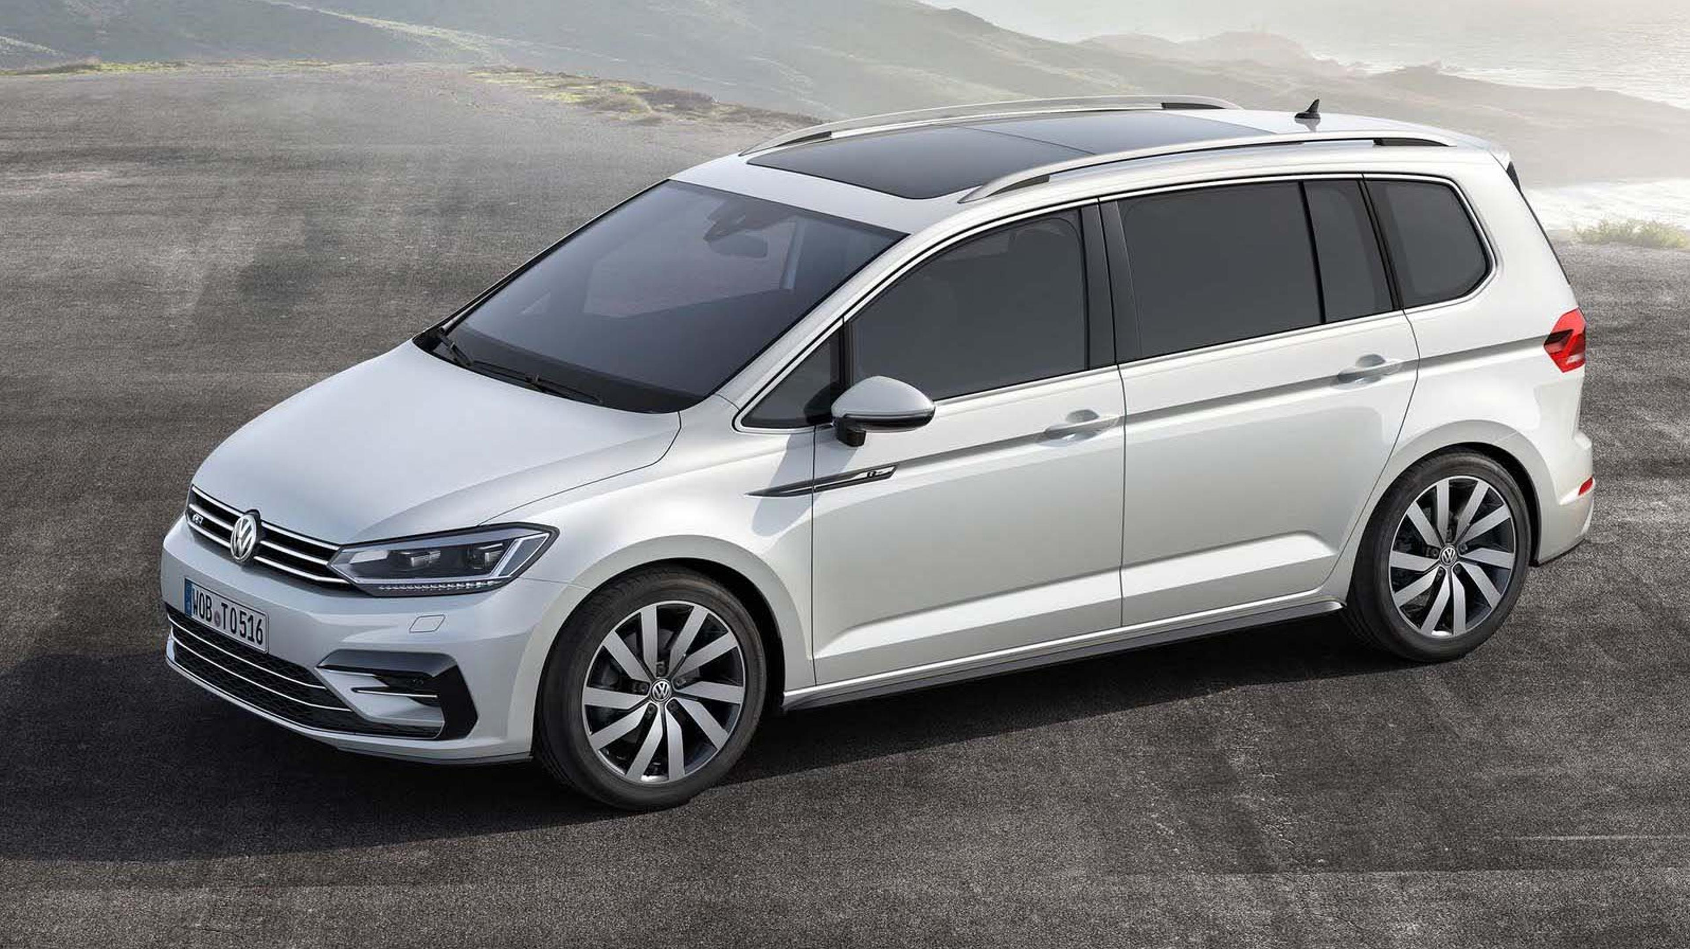
19) MPV (multipurpose vehicle)
An MPV is a large car for people.
It has many seats and lots of space.

Slide 21
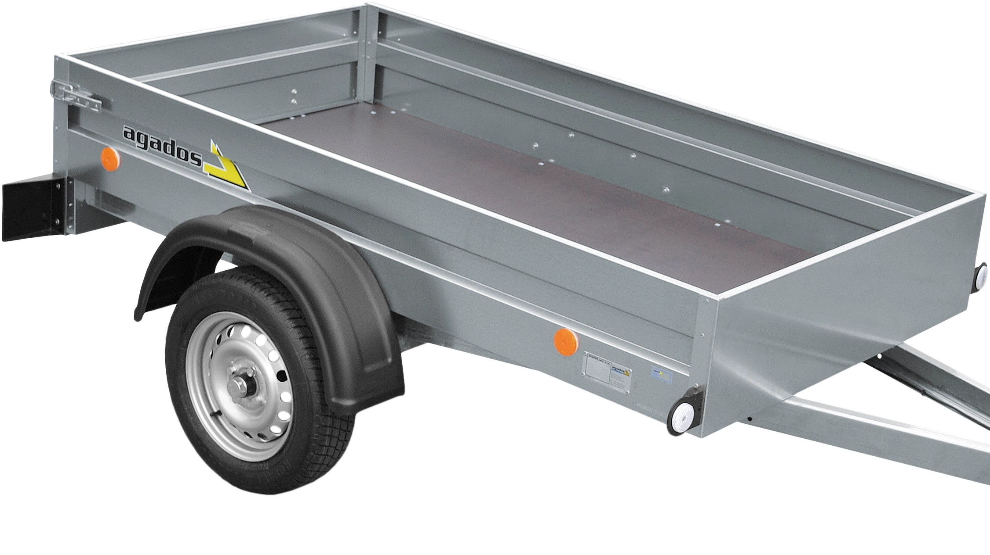
20) BOX TRAILER
A box trailer is pulled by a car or van.
It carries cargo in a covered box.

