Slide 1
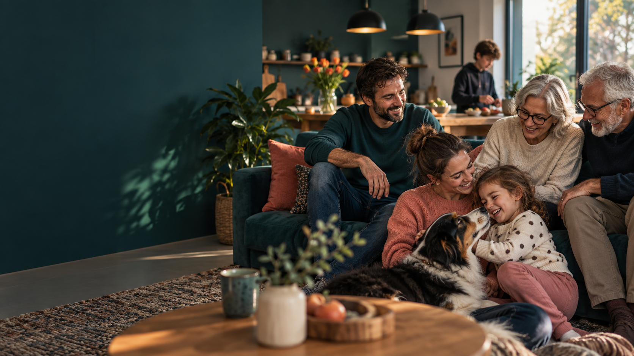
MATURITA · ENGLISH
Family,
Relationships
and Everyday Life
A speaking guide for a clear, personal and well-developed answer
B1–B2
Notes:
Opening slide. Generated editorial image; no external source citation required.

Slide 2
Build one connected story
02
Six parts that naturally lead from facts to your own opinion
01
Family
02
One person
03
Relationships
Who lives with you?
What makes them special?
How do you support each other?
04
Daily life
05
Free time
06
Opinion
School, chores and routine
Hobbies and traditions
What matters to you?
Do not describe everybody in the same way.
Family · Relationships · Everyday Life
Notes:
Use this route as the overall logic of the answer. The exact exam task may require more time on one part.

Slide 3
1. My family in brief
03
Start with context — then move quickly to relationships
30–45
seconds
family size and type
who do you live with
where do your relatives live
how often do you meet
Useful opening
I come from a small / large / close family.
Most of my relatives live nearby / abroad.
Keep it brief
Family · Relationships · Everyday Life
Notes:
Prompt students to introduce their household without listing every relative in detail.

Slide 4
2. Focus on one important person
04
Combine facts, personality, your relationship and evidence
FACTS
age · job · school
My older brother is quite tall and wears glasses. He is outgoing and funny, although he can be impatient. I look up to him because he works hard and always makes time to help me.
LOOKS
one or two details
PERSONALITY
two qualities
RELATIONSHIP
why you are close
adjective + reason + example
Family · Relationships · Everyday Life
Notes:
The example is a model only. Students should replace the details with their own information.

Slide 5
3. Talk about relationships
05
These phrases make the answer more mature and less repetitive
get on well with
have a good relationship
look up to
admire and respect
take after
be similar to a relative
rely on / count on
trust someone to help
I am closest to my mother because I can talk to her openly.
Family · Relationships · Everyday Life
Notes:
Ask students to choose two phrases and make true sentences about their family.

Slide 6
4. Everyday life at home
06
Show how the family works as a team
1
2
3
4
MORNING
AFTERNOON
EVENING
WEEKEND
different schedules
school · work · errands
chores · dinner · rest
bigger jobs · shared time
I am responsible for…
walking the dog
taking out the rubbish
cooking
vacuuming
shopping
Family · Relationships · Everyday Life
Notes:
Encourage students to explain whether chores are shared fairly and how weekdays differ from weekends.

Slide 7

5. My typical school day
07
Select key moments — do not recite a timetable
get up and get ready
commute by bus / train
general + vocational subjects
practical training
homework, rest and preparation
My favourite subject is … because …
Notes:
Generated editorial image; no external source citation required. Ask for reasons and comments on work-life balance.

Slide 8

6. Free time
08
Choose one hobby and develop it
ACTIVE
cycling · sport · hiking
CREATIVE
music · photos · cooking
RELAXING / SOCIAL
films · games · friends
What does your hobby give you?
Notes:
Generated editorial image; no external source citation required. Avoid gender stereotypes when discussing hobbies.

Slide 9
Describe one hobby in detail
09
Six prompts can turn one sentence into a full minute
WHAT?
name the activity
NEXT?
WHEN?
future plans
how you started
MY
HOBBY
WHY?
HOW OFTEN?
benefits and feelings
your routine
WITH WHOM?
alone or together
Family · Relationships · Everyday Life
Notes:
Students can use the six prompts to plan a detailed description of cycling, gaming, music, photography or another hobby.

Slide 10
Family traditions and shared time
10
Small routines can reveal what a family values
WEEKLY
BIRTHDAYS
SUMMER
CHRISTMAS
Sunday walk or film
homemade cake
trip or barbecue
wider family meets
One tradition I really enjoy is … because …
Do phones bring your family together — or interrupt family time?
Family · Relationships · Everyday Life
Notes:
Use traditions to connect free time with relationships. Invite a short opinion about phones and social media.

Slide 11
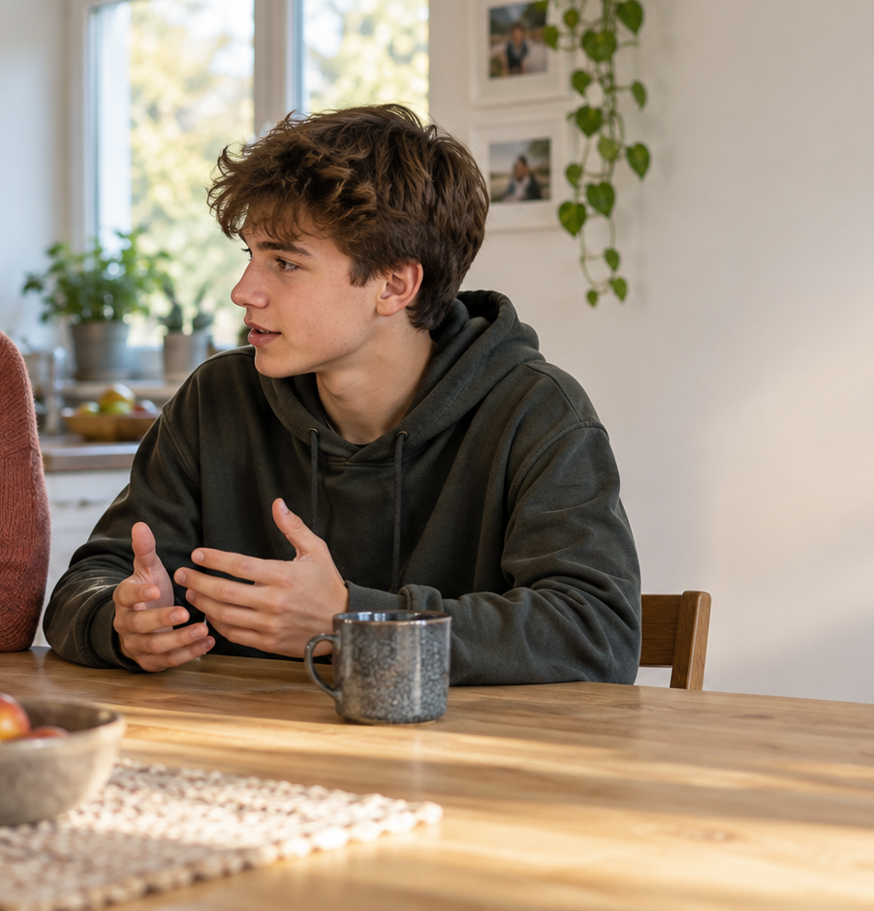
7. Problems and support
11
A realistic answer may include one ordinary disagreement
1
explain the problem
2
listen calmly
3
share viewpoints
4
find a compromise
Even when we disagree, we can count on each other.
Notes:
Generated editorial image; no external source citation required. Students do not need to reveal sensitive personal information.

Slide 12
8. Generations and modern families
12
Move from personal experience to a wider opinion
YOUNGER
OLDER
technology
new study methods
changing lifestyles
experience
family history
practical advice
What can the generations learn from each other?
Technology connects distant relatives; it can also reduce face-to-face conversation.
Family · Relationships · Everyday Life
Notes:
Possible extensions: both parents working, young adults leaving home later, grandparents, video calls and privacy.

Slide 13
9. Finish with your opinion
13
A strong conclusion is personal, short and memorable
“A good family does not have to be perfect.”
TRUST
RESPECT
SUPPORT
In the future, I would like to …
Family · Relationships · Everyday Life
Notes:
Students can conclude with what family means to them, what they have learned, or which tradition they want to keep.

Slide 14
A 7-minute speaking map
14
Use keywords — never memorise every sentence
0:00
0:45
1:45
2:45
4:00
5:15
6:30
family
one person
relationships
daily life
hobby
conflict + society
opinion
answer
+
reason
+
example
Family · Relationships · Everyday Life
Notes:
Timing is approximate. Students should adapt the structure to the exact task and examiner follow-up questions.

Slide 15
Possible examiner questions
15
Practise extending every answer with a reason and an example
1
2
3
Who are you closest to?
How are chores divided?
What is your main hobby?
Do you take after a parent?
What is your typical school day?
Has technology changed families?
What do you argue about?
Which subject is most useful?
What makes a good parent?
Family · Relationships · Everyday Life
Notes:
More questions are available in the accompanying Word document. Use these nine for classroom practice.

Slide 16
Your turn
16
Prepare a personal answer — not a biography of every relative
✓
introduce the family briefly
✓
describe one person with evidence
✓
explain relationships and chores
✓
connect school and free time
✓
mention one conflict and solution
✓
finish with your opinion
Speak naturally. Give reasons. Add examples.
Family · Relationships · Everyday Life
Notes:
Final self-check. Invite the student to use only keywords and give a complete practice answer.

